Slide 1


Global MBA Research Methods And Consulting Project (BMBA5007)
Exploring and Evaluating Strategic Partnership Opportunities for a Europe-Based API Pharmaceutical Company
Student Name: Samurdi Sandaruwani

Slide 2





Introduction & Research Focus
India as Partner
Strong Active Pharmaceutical Ingredient ( API) & biotech capabilities, cost-efficient (Feller, 2003)
X Company & Research Problem
Europe-based anti-infective API manufacturer
Strengths: global B2B presence, R&D, facilities
Challenges: narrow pipeline, high costs, limited innovation
Research Aim
To explore and evaluate potential partnership opportunities with Indian pharmaceutical and biotechnology companies for a Europe-based API pharmaceutical company X to support growth and diversification strategies.
Research Questions
What external and internal factors influence partnership opportunities between the European API company X and Indian pharmaceutical companies?
What criteria and tools are most suitable for assessing potential Indian partners?
Which Indian companies present the strongest strategic fit for partnership with company X, and why are they suitable?

Slide 3



Research Approach
Case study within mixed-methods framework
Purposive sampling
Macro & micro analysis: PESTEL, Porter’s Five Forces, SWOT of X.
Partner selection guided by X’s management criteria : Regulatory, financial & operational factors; product, manufacturing & therapeutic alignment; market access, export capability & geographic presence; strategic fit & collaboration readiness
Partner personas applied:
Ia: Anti-infective API- focused firms
Ib: Multi-therapeutic API firms
II: API units spun off from innovation-driven generics
III: Late-stage antibiotic innovators
Data Triangulation
Top 5
Partners
Limited Primary Input
﻿• 3 contextual responses
﻿• No survey response
Analytical Frameworks
• Partner Evaluation Framework
﻿• Partner Scorecard • ﻿SAF ﻿• SWOT
Secondary Data Sources
• PharmaCompass • EudraGMP
• Company Websites, Reports • Literature
Data Collection
Primary: online survey targeting senior business professionals
Survey Design: based on literature; 5-point Likert + open-ended questions
Method: Microsoft Forms - secure, accessible
Validation: Pilot tested (industry expert + supervisor); readability Grade 11 (Radhakrishna, 2007)
Distribution: LinkedIn, emails, corporate forms

Slide 4

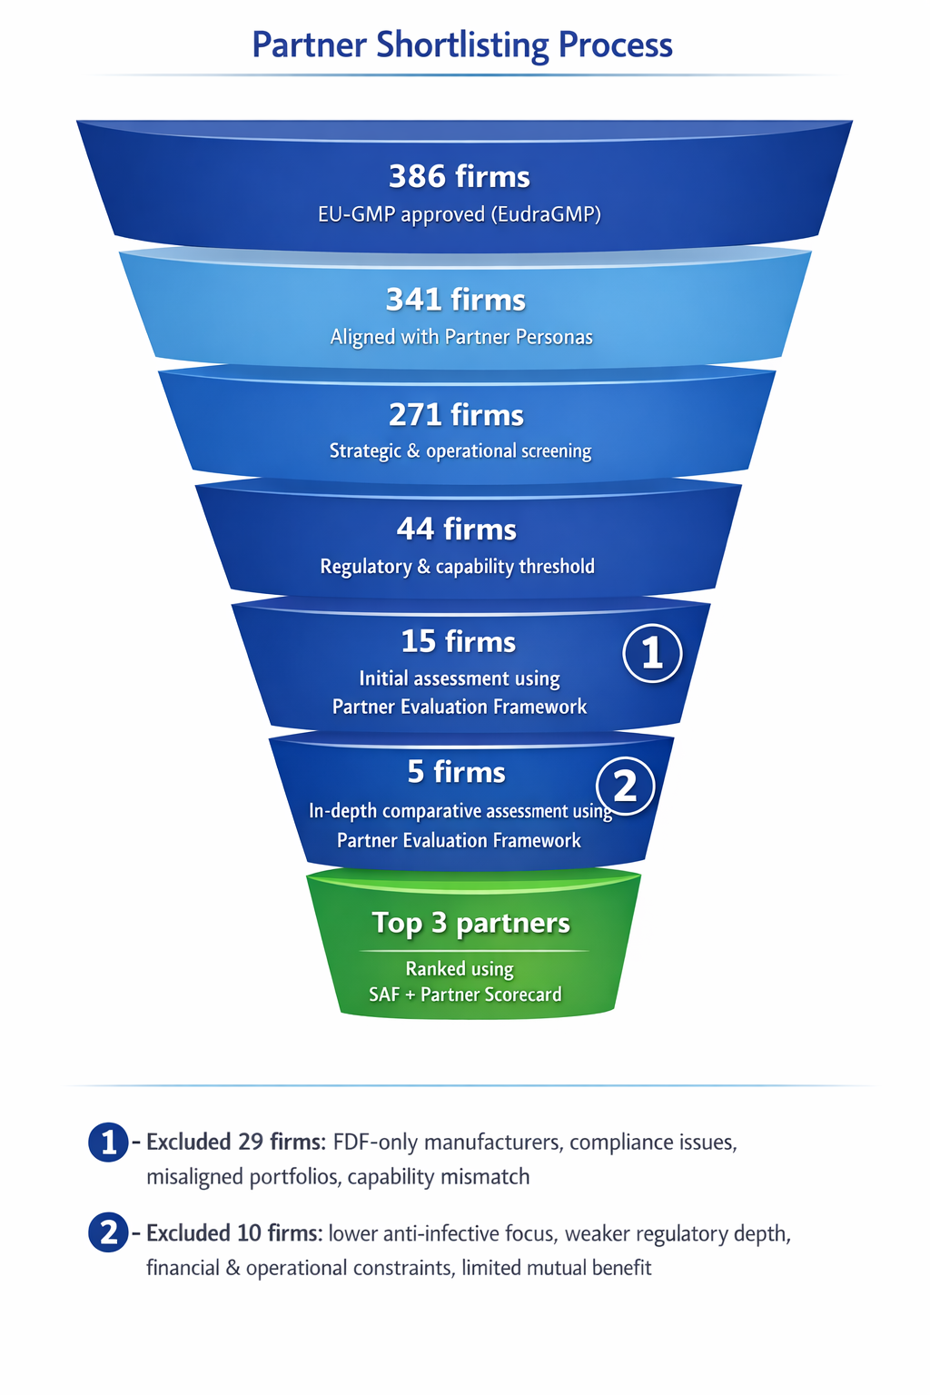


Partner Evaluation Framework (Based on Literature)
Partner Shortlisting
Dimension | Key Indicators | Authors
Strategic Fit | Market & portfolio alignment | (Wu et al., 2009; Zhang et al., 2013; Mindruta et al., 2016; Sadovnikova et al., 2016; Festel et al., 2014)
Operational Fit | Technology & regulatory compliance | (Zhang et al., 2013; Mindruta et al., 2016; Cummings et al., 2012; Festel et al., 2014; Papadopoulou and Hecht, 2021; Esen and Alpay, 2017; Khanna, 2025)
Relational Fit | Reputation, collaboration willingness | (Papadopoulou and Hecht, 2021; Khanna, 2025; Cummings et al., 2012)
Financial Fit | Stability & risk profile | (Zhang et al., 2013; Festel et al., 2014; Khanna, 2025; Cummings et al., 2012)
Excluded due to
﻿Finished Dosage Forms (FDF) only focused, compliance issues, misaligned portfolios, or capability mismatch
﻿
Excluded due to lower anti-infective specialization, weaker regulatory strength, financial or operational constraints, or limited potential for mutual benefit.

Slide 5
Findings
Rank | Partner | SAF Score | Partner Scorecard | Strategic Assessment
1 | Orchid Pharma | 4.7 / 5 | 4.83 / 5 | Co-development; injectable FDF API supply; Enmetazobactam global licensing; cost synergies; under-commercialized API portfolio; antimicrobial resistance stewardship alignment (Orchid Limited, 2025).
2 | Concord Biotech | 4.4 / 5 | 4.71 / 5 | EU expansion via X; scalable contract development and manufacturing organization (CDMO); low-cost access; under-commercialized APIs; access; strong pipeline (Concord Biotech Limited, 2025).
3 | Alivus Life Sciences | 4.2 / 5 | 4.45/ 5 | Large API portfolio; co-development; improved CDMO utilization; strong pipeline (Alivus Life Sciences Limited, 2025).
4 | Virchows Group | 4.16 / 5 | 4.33 / 5 | Strong anti-infective and fermentation alignment; contract research and manufacturing services (CRAMS); high technical strength; limited financial transparency (Virchows Group, 2025).
5 | Shamrock Pharmachemi | 3.5 / 5 | 3.65 / 5 | Strong API and CRAMS base; good technical fit in critical-care APIs; financial and governance risk arising from the Unimark Remedies acquisition and its associated debt (Shamrock Pharmachemi, 2025).
Top Three Partner Comparison

Slide 6
Corporate Social Responsibility Collaboration: X & Orchid Trust
Joint impact: combines local reach + international standards → stronger social & environmental outcomes
Basis of forecast :
Profit After Tax (PAT) growth derived from recent performance (12% CAGR)
Partnership synergies assumed at 15% (EY, 2022) → 27% combined growth
CSR calculation:
Indian CSR rule: 2% of average PAT (preceding 3 years) + X’s annual CSR contribution
Projected total CSR spend
FY26: INR 1.8 crore
FY27: INR 2.32 crore
FY28: INR 2.85 crore
Collaboration enables progressive CSR growth, aligned with statutory requirements and ESG expectations
Forecast of CSR Expenditure for X-Orchid Collaboration

Slide 7




Conclusion & Recommendations
Conclusion
Indian partnerships Enhances X’s revenue, reduces costs, improves pipeline & innovation, diversifies revenue streams, and strengthens growth
Top partners: Orchid , Concord & Alivus → high strategic fit, diversification, revenue potential
Lower-ranked partners: Virchow, Shamrock → technically relevant but carry moderate financial/operational risks
Recommendations
Prioritize Orchid Pharma: initiate engagement within 6–12 months; leverage X’s global distribution network to commercialize under-utilized APIs,
Optimize costs & operations: use Orchid’s manufacturing scale, downstream facilities, and upcoming injectable facility
CSR collaboration: integrate X’s sustainability expertise with Orchid Trust’s local impact
Complementary partnerships: pursue Concord and Alivus for CDMO and API pipeline opportunities.
Alignment with Research Objectives
Objective | Outcome
RO1: Analyse external & internal factors | India’s strengths (cost-efficient manufacturing, fast approvals, strong R&D) help X overcome its gaps (high costs, narrow pipeline)
RO2: Apply evaluation framework | Partner Evaluation Framework developed, Partner Scorecard & SAF applied
RO3: Identify suitable partners | Orchid, Concord, Alivus selected as top partners

Slide 8
References
Alivus Life Sciences (2025b) Alivus Life Sciences Integrated Annual Report 2024–25. Available at: https://bunny-wp-pullzone-zhbiessutg.b-cdn.net/alivus_pdfs/investors/financials/reports_presentation/Integrated_Annual_Report_2024-25.pdf (Accessed: 15 January 2026).
Alivus Life Sciences Limited (2025) ‘Alivus Life Sciences Limited Q2 FY26 Earnings Conference Call, 7 November 2025’. Available at: https://bunny-wp-pullzone-zhbiessutg.b-cdn.net/alivus_pdfs/investors/financials/reports_presentation/Transcript_Alivus%20Life%20Sciences_Earnings%20Call_Q2FY26.pdf (Accessed: 15 January 2026).
Concord Biotech Limited (2025a) Concord Biotech Limited Annual Report FY 2024–2025. Available at: https://concordbiotech.com/wp-content/uploads/2025/09/Annual-Report-FY-2024-2025-2.pdf (Accessed: 15 January 2026).
Concord Biotech Limited (2025c) ‘Concord Biotech Limited Transcripts of Q2 & H1 FY26 Earnings Call, 14 November 2025’. Available at: https://concordbiotech.com/wp-content/uploads/2025/11/Q2FY26-2.pdf (Accessed: 15 January 2026).
Cummings, J.L. and Holmberg, S.R. (2012) ‘Best-fit Alliance Partners: The Use of Critical Success Factors in a Comprehensive Partner Selection Process’, Long Range Planning, 45(2–3), pp. 136–159. Available at: https://doi.org/10.1016/j.lrp.2012.01.001.
Esen, A. and Alpay, G. (2017) ‘Exploring the impact of firm- and relationship-specific factors on alliance performance: Evidence from Turkey’, South African Journal of Business Management, 48(2), pp. 11–21. Available at: https://doi.org/10.4102/sajbm.v48i2.24.
Eudra GMP – Public Layout. Available at: https://eudragmdp.ema.europa.eu/inspections/gmpc/searchGMPCompliance.do (Accessed: 15 January 2026).
Feller, G. (2003) ‘Biotech industry grows in India’, Research Technology Management, 46(4), p. 4. Available at: https://www.jstor.org/stable/43240092 (Accessed: 15 January 2026).
Festel, G., Nardo, M.D. and Simmen, T. (2014) ‘Outsourcing of Pharmaceutical Manufacturing – A Strategic Partner Selection Process’, Journal of Business Chemistry, 11(3), pp. 117–132.
Khanna, R. (2025) ‘Knowledge Creation Through Technical Collaborations: Evidence from Indian Pharmaceutical Case Studies’, International Journal of Innovative Research in Technology, 11(11).
Mindruta, D., Moeen, M. and Agarwal, R. (2016) ‘A two-sided matching approach for partner selection and assessing complementarities in partners’ attributes in inter-firm alliances’, Strategic Management Journal, 37(1), pp. 206–231. Available at: https://doi.org/10.1002/smj.2448.
Orchid Pharma Limited (2025a) Orchid Pharma Limited Annual Report 2024–2025. Available at: https://www.orchidpharma.com/downloads/annualreports/Annual%20Report%202024-2025.pdf (Accessed: 15 January 2026).
Orchid Pharma Limited (2025b) ‘Orchid Pharma Limited Q2 FY26 Earnings Conference Call, 11 November 2025’. Available at: https://www.orchidpharma.com/downloads/Transcript%20of%20earning%20call_Q2_F.Y._25-26.pdf(Accessed: 15 January 2026).
Papadopoulou, X. and Hecht, F. (2021) Factors influencing the partner selection by pharmaceutical companies and biotechnology start-ups in Open Innovation settings: A Case Study of LEO Pharma Open Innovation. Copenhagen Business School. Available at: https://research-api.cbs.dk/ws/portalfiles/portal/68334329/1155573_Master_Thesis_Hecht_Papadopoulou_2021.pdf (Accessed: 15 January 2026).
PharmaCompass (n.d.) Grow Your Pharma Business Digitally. Available at: https://www.pharmacompass.com/(Accessed: 15 January 2026).
Radhakrishna, R.B. (2007) ‘Tips for Developing and Testing Questionnaires/Instruments’, The Journal of Extension, 45(1), p. 25. Available at: https://open.clemson.edu/joe/vol45/iss1/25 (Accessed: 15 January 2026).
Sadovnikova, A., Pujari, A. and Mikhailitchenko, A. (2016) ‘Radical innovation in strategic partnerships: A framework for analysis’, Journal of Business Research, 69(5), pp. 1829–1833. Available at: https://doi.org/10.1016/j.jbusres.2015.10.064.
Shamrock Pharmachemi (2025) Shamrock Pharmachemi. Available at: https://www.shamrockpharmagroup.com(Accessed: 15 January 2026).
Ural, A. and Boodhoo, A. (2025) How life sciences executives can rally teams to achieve M&A synergies, EY. Available at: https://www.ey.com/en_cn/insights/strategytransactions/how-life-sciences-executives-can-achieve-m-a-synergies(Accessed: 8 December 2025).
Virchow Group (2025) Virchow Group. Available at: https://virchows.com (Accessed: 15 January 2026).
Wu, W.Y., Shih, H.-A. and Chan, H.-C. (2009) ‘The analytic network process for partner selection criteria in strategic alliances’, Expert Systems with Applications, 36(3), pp. 4646–4653. Available at: https://doi.org/10.1016/j.eswa.2008.06.049.
Zhang, M. et al. (2013) ‘Evaluating outsourcing partners’ capability: a case study from the pharmaceutical supply chain’, Journal of Manufacturing Technology Management, 24(8), pp. 1080–1101. Available at: https://doi.org/10.1108/JMTM-02-2012-0023.

Slide 9

Thank You..

